Slide 1

Module One: Introduction
CIS 311 – Prof. C. R. Johnson

Slide 2


Slide 3
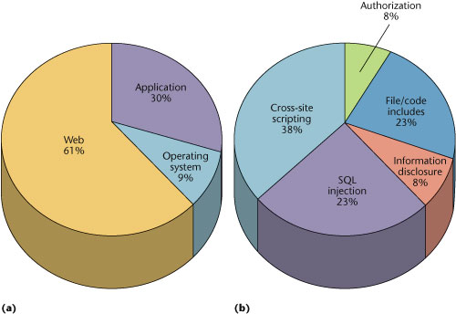

Slide 4
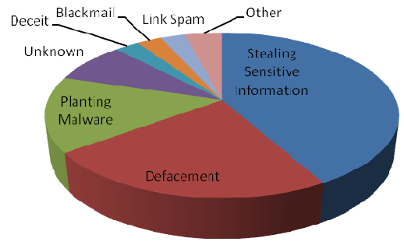

Slide 5

Firewalls Don’t Protect Web Apps
telnet
Firewall
ftp
Application
Web Client
Web Server
Database Server
Application
HTTP Traffic
Port 80
Notes:
Diagram from Ivan OWASP AppSec EU 2006.

Slide 6
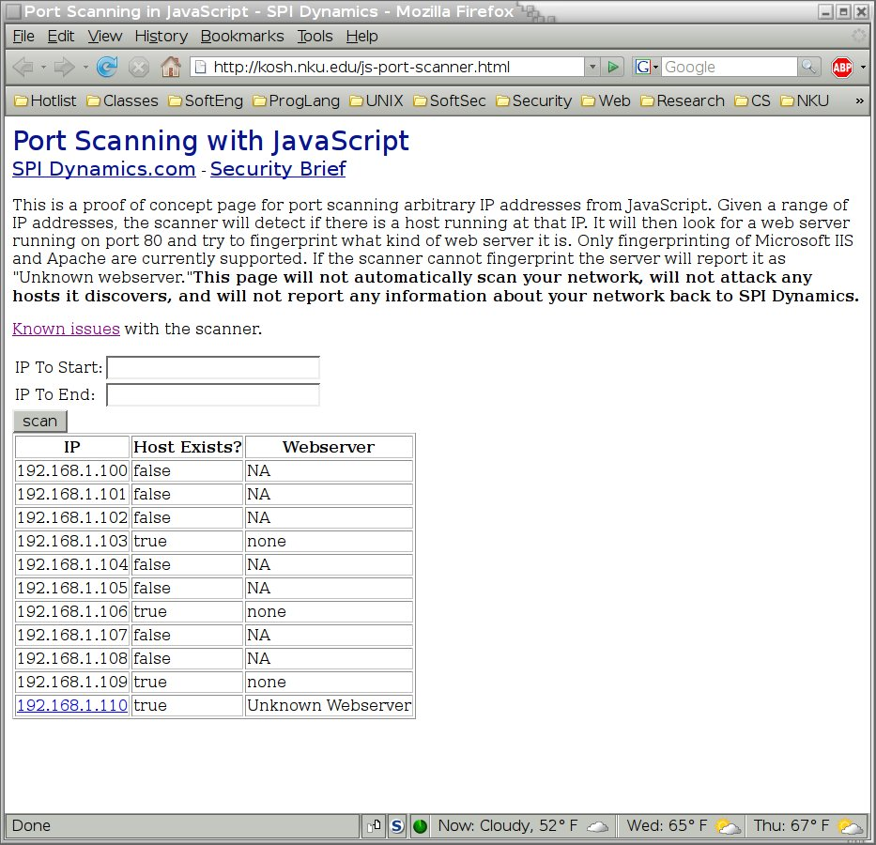

Slide 7
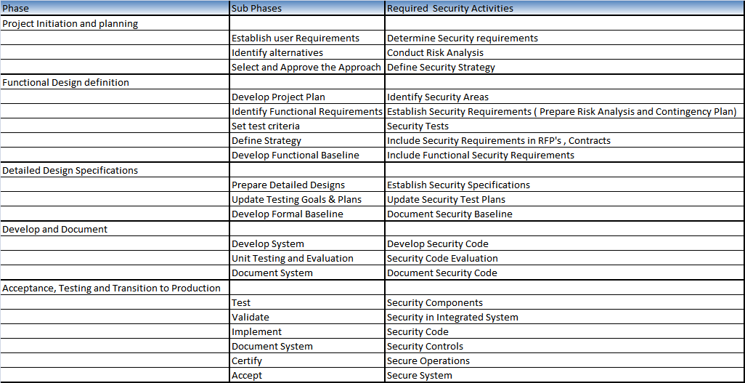
Software Protection
Methodology of a System Development life Cycle:
7
Notes:
7

Slide 8
Software Protection
System Life cycle
Proper media Destruction or sanitization should be done
Software Development Methods
There are several methods that have evolved the following are some of the methods:
Spiral
Waterfall
Computer Aided Software Engineering (CASE)
Rapid Application Development
Prototyping, etc
8
Notes:
8

Slide 9
Audit Assurance Mechanisms
Assurance is important in system and application development
Mechanisms
Integrity of information
Information Auditing
Malware Assurance
Effective and workable policies are one of the best protections against malware of all kinds.
Change Management
Proper change management process is vital to continued software assurance
9
Notes:
9

Slide 10
Audit Assurance Mechanisms
Testing
Purpose is to find problems before the change is implemented
Address all normal and unexpected entries
Privacy is an important issue in testing
Configuration Management
Monitor and manage changes to application programs, documentation, hardware
Patch Management
Problems in patch management like:
Patch Failure
Patch rollback
Distributed System Failures
10
Notes:
10

Slide 11
Database and Warehousing Environment
Database Environment
Developed to manage information from many sources in one location
Provides
Transaction Persistence
Fault Tolerance and Recovery
Sharing by multiple Users
Security Controls
Many DBMS Models such as
Hierarchical, Network
Relational, Object-oriented
11
Notes:
11

Slide 12
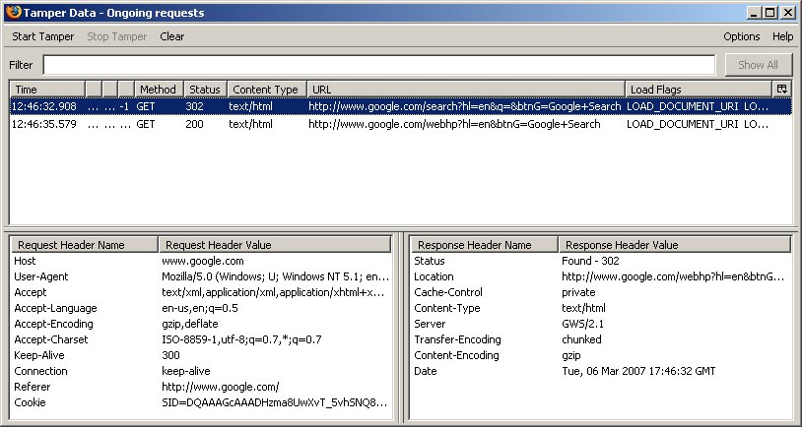
Web Proxies

Slide 13
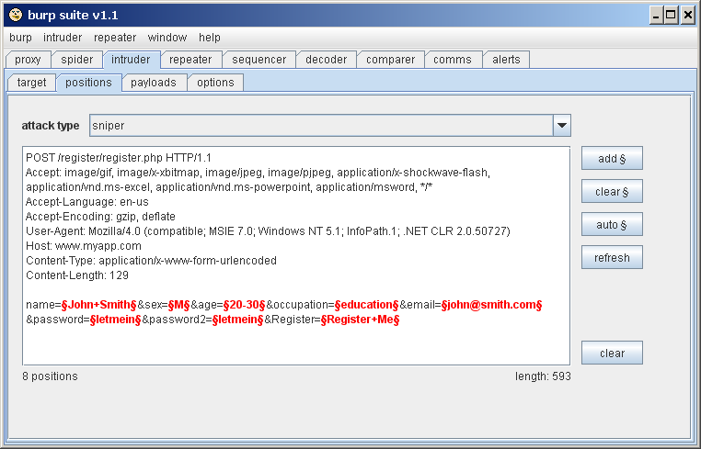
Fuzz Testing
Fuzz testing consists of
Sending unexpected input.
Monitoring for exceptions.
Notes:
http://portswigger.net/intruder/screenshots.html

Slide 14
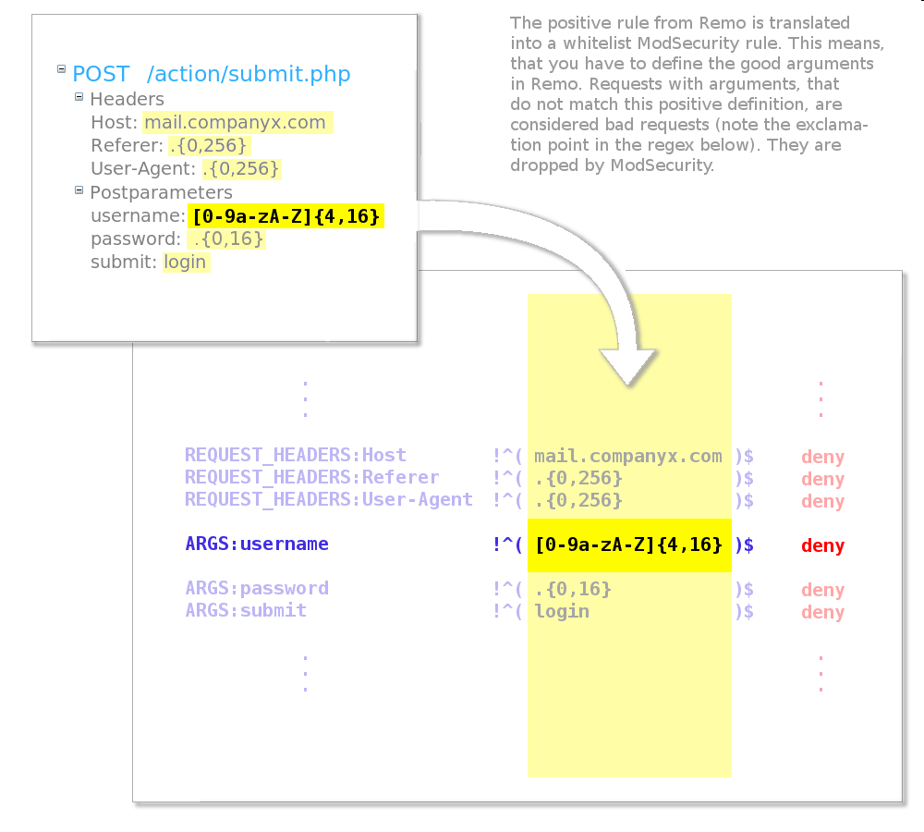
Web Application Firewalls
What is a WAF?
Web monitoring.
Access control.
Behind SSL endpoint.
A/K/A
Deep packet inspection.
Web IDS/IPS.
Web App Proxy/Shield.
mod_security
Open source.
Embeds in Apache.
Reverse proxy.

Slide 15
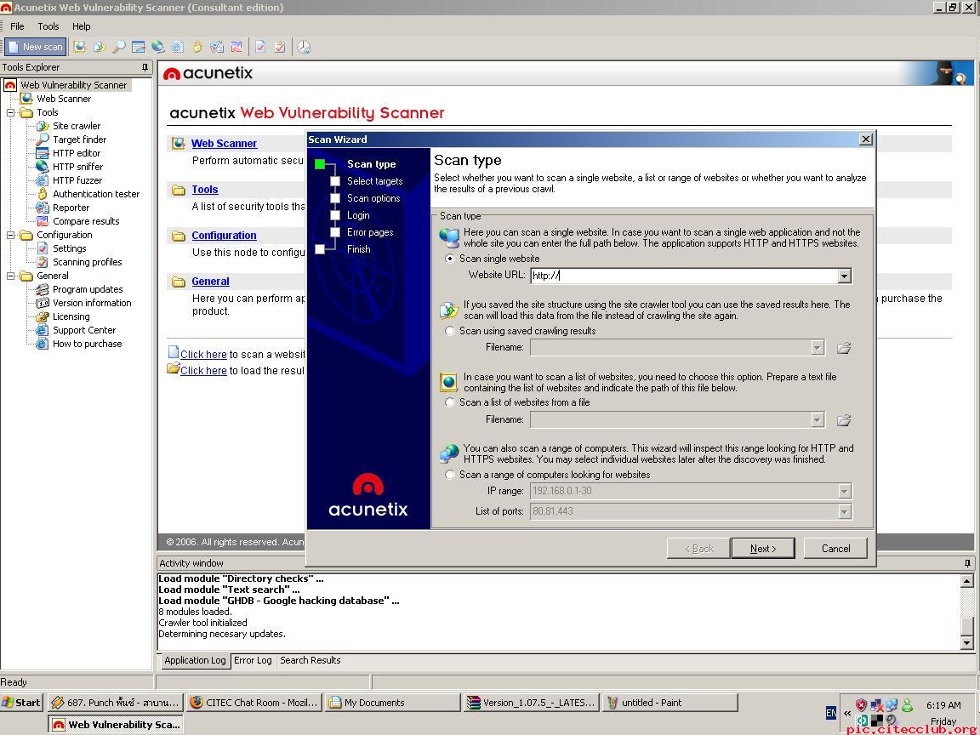
Vulnerability Scanners
Spiders site.
Identifies inputs.
Sends list of malicious inputs to each input.
Monitors responses.

